Slide 1


DKCAA oversight with
”Examiners”

Slide 2

The Examiner
Conducts tests for issue of certificates
Conducts tests for issue of privileges
Conducts tests for revalidation/renewal of privileges

Slide 3

In the old days
JAR–FCL 1.030: Arrangements for testing Authorization of examiners.
“The Authority will designate and authorize as
examiners suitably qualified persons of integrity
to conduct on its behalf, skill tests and proficiency
checks.”
_____________________________________________________
“The examiner shall comply with appropriate
examiners’ standardization arrangements made
or approved by the Authority.”
Notes:
Arbejdede på vejne af myndigheden og med dennes mandat. Standardisering ved møder etc

Slide 4

Safety
The Authority
The organisations
Notes:
Seationær standard

Slide 5
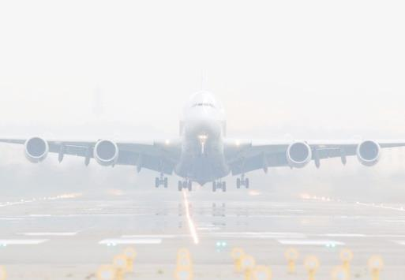
”Today”
Examiners must fulfill requirements of Subpart K
Examiners works on behalf of themself
Examiners can be Instructors at an ATO

Slide 6

Safety
DKCAA
The organisations
Notes:
Risiko for at standarden ændrer sig

Slide 7
DKCAA oversight
PPL(A) full tests only
Only enter duration if test is passed !
Kol. 1 | Kol. 2 | Kol. 3 | Kol. 4 | Kol. 5 | Kol. 6
Date | Result, mark wift "1" |  |  | Duration | block
dd.mm.yy | pass | fail | partial | hours | minutes
10.01.13 | 1 |  |  | 1 | 30
10.01.13 | 1 |  |  | 1 | 15
10.01.13 |  | 1
23.01.13 | 1 |  |  | 1 | 55
03.02.13 |  |  | 1
03.02.13 | 1 |  |  | 1 | 10
05.02.13 | 1 |  |  | 0 | 35
08.02.13 |  | 1
08.02.13 | 1 |  |  | 2 | 0
10.02.13 | 1 |  |  | 2 | 10
10.02.13 |  | 1
13.02.13 |  |  | 1
16.03.13 | 1 |  |  | 1 | 20

Slide 8

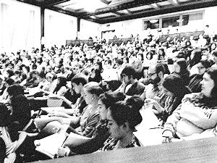
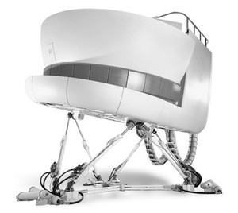

Oversight
Statistics
Examiner seminar
Examiner training
Examiner assessment
Spotcheck

Slide 9
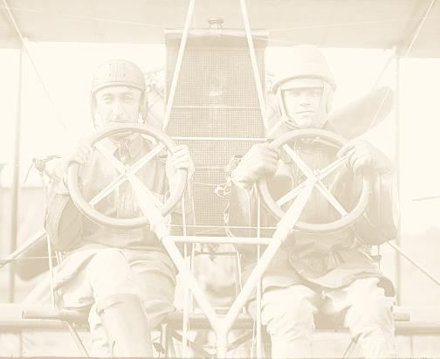
Senior examiners
Examiner assessment
Assisting the Authority
(Examiner seminar)
(Examiner training)

